Slide 1
Helpdesk and Print Logic
Jaime Escalante Middle School

Slide 2
IT Helpdesk
This is a portal for all district employees to use for technology issues.
Anyone can place a ticket.
MIS technicians and campus CIT’s have access to view tickets.

Slide 3
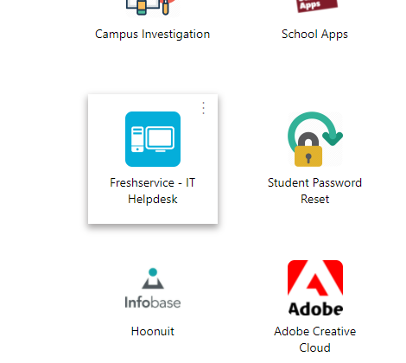
How to access?
You can visit: helpdesk.psjaisd.us
You can go to “My Apps” and search for IT Helpdesk.
Email: helpdesk@psjaisd.us

Slide 4
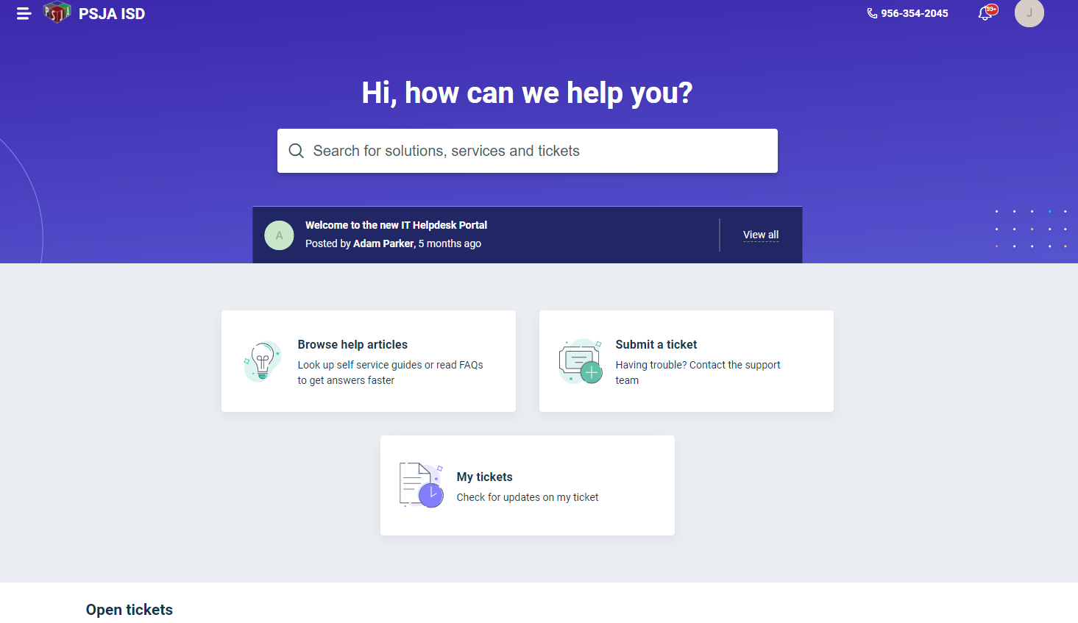
What the portal looks like:
Click Here!

Slide 5
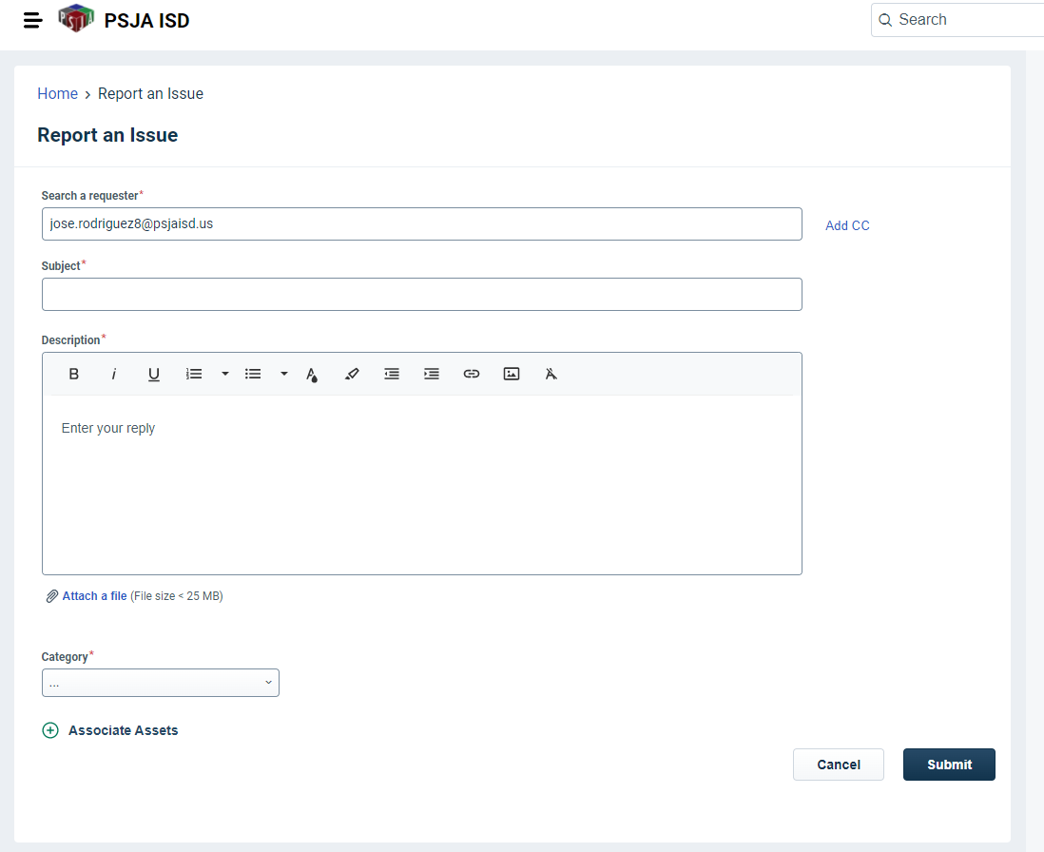
What the ticket portal looks like:
Your name will auto populate, you do not need to edit this but you can CC me.
On your subject line please include room number and small description (Newline, HP, Audio, Printer, etc.)
This is the most important piece! Please be as descriptive as possible. A good way to start this is, “At escalante middle school, in room #123, my _____ is having the following issue….” If you are dealing with a computer, always include computer name.

Slide 6
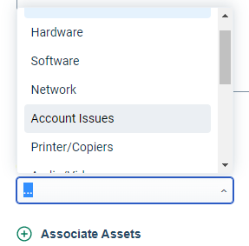
Selecting Categories
Category Options: Hardware, software, Network, Account Issues, Printer/Copiers, Audio/Video, Voice/Phone, Security Surveillance, Facility Systems, Damaged, Missing/Stolen, Inventory, Warranty (MIS Only)
Pick the category that best fits what is happening, do not be afraid to make mistakes here.

Slide 7
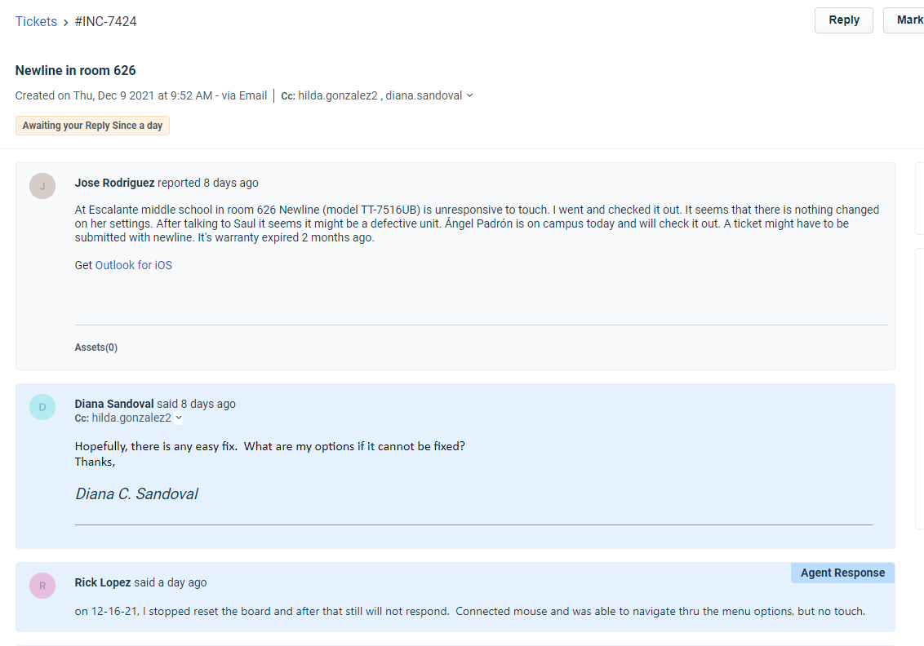
Example of Ticket

Slide 8
How to Email Ticket:

Slide 9
What Happens After Ticket?
After Ticket is submitted you will get a confirmation email and one of three things will happen:
MIS will remotely work on the issue if possible
I will go and work on the issue if it is within my “rights” and close the ticket if resolved
An MIS tech will physically show up and work on the issue.

Slide 10
PrintLogic
PrintLogic is our printer network and its rights have been extended to all campus users!
You can access this by going to: printers.psjaisd.us
You must go through EDGE or Internet Explorer
DO NOT USE CHROME.

Slide 11
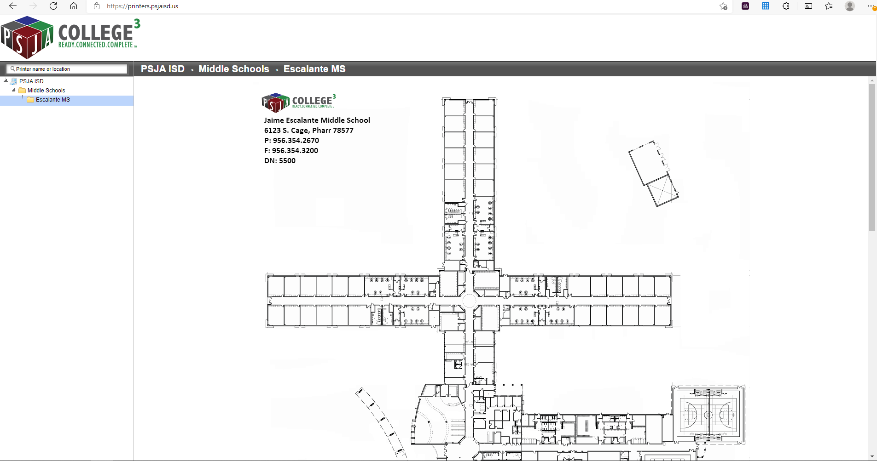
What it looks like:

Slide 12
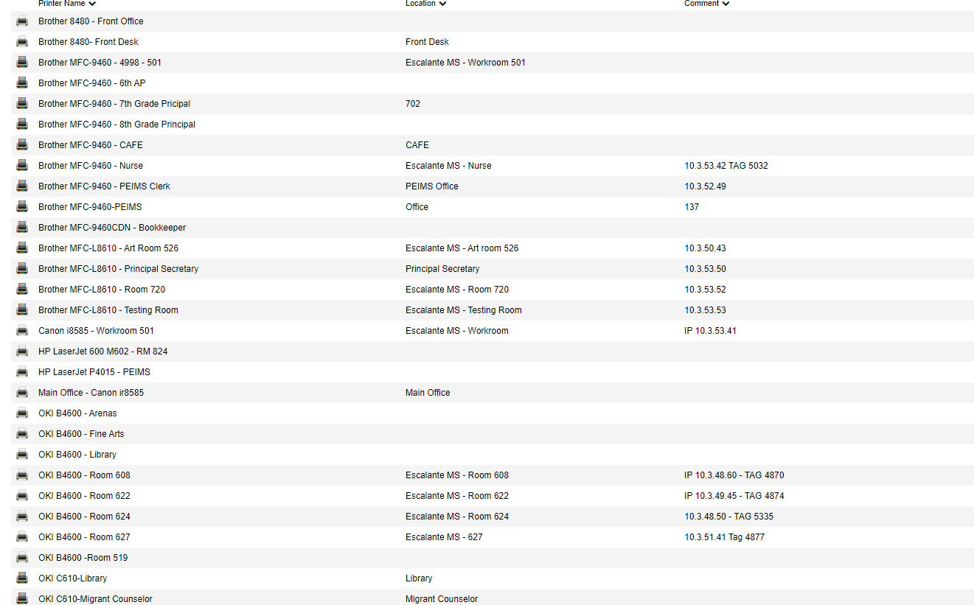
What to connect to:
Not all campus printers are on printlogic but, the main need (the canons in 501) are available at all times on this portal.
All you will have to do is click on the printer's name (workroom/main office) and confirm installation.

